Slide 1
The State of Funding for Florida Schools
Pressures Facing Polk County
Jason W. Pitts, Senior Director of Finance

Slide 2
How Does Polk County Compare to other Districts in the Nation?
1
28th Largest District in the nation (# of Students)
Funded 995th out of the top 1,000 largest school districts (13,588 districts in the US)
New York and Illinois - $23,000 per student
West Virginia - $14,000 per student
Florida - $7,000 per student

Slide 3
How Does Polk Compare to other Districts in Florida?
2
Polk County is the 7th largest district in the state
Polk County is funded 64th of 67 districts (bottom four)
Polk offers second highest beginning teacher salary in state (as of 2016/2017)
Polk’s average teacher salary is 25th in the state
Polk’s spending on administrative costs is the 4rd lowest in the state

Slide 4
Additional Funding Challenges
3
Polk County has high poverty and ESE designated students
Polk County is unique as an urban and rural county
Extremely high transportation costs due to size and layout of county (state funding only covers 60% of costs)
Polk County is larger than the state of Rhode Island
511 buses transport over 49,000 students
41,670 miles travelled each day (24,901 miles)

Slide 5
Transportation Funding vs. Expense
4
Expense
Funding

Slide 6
Florida’s Financing Model
5
Reported in the press as “Dollars per Student”
Called the FEFP – Florida Education Financing Program
To receive state assistance districts must use Required Local Effort
When designed, it attempted to equalize funding across districts
Funding is primarily property tax and sales tax

Slide 7
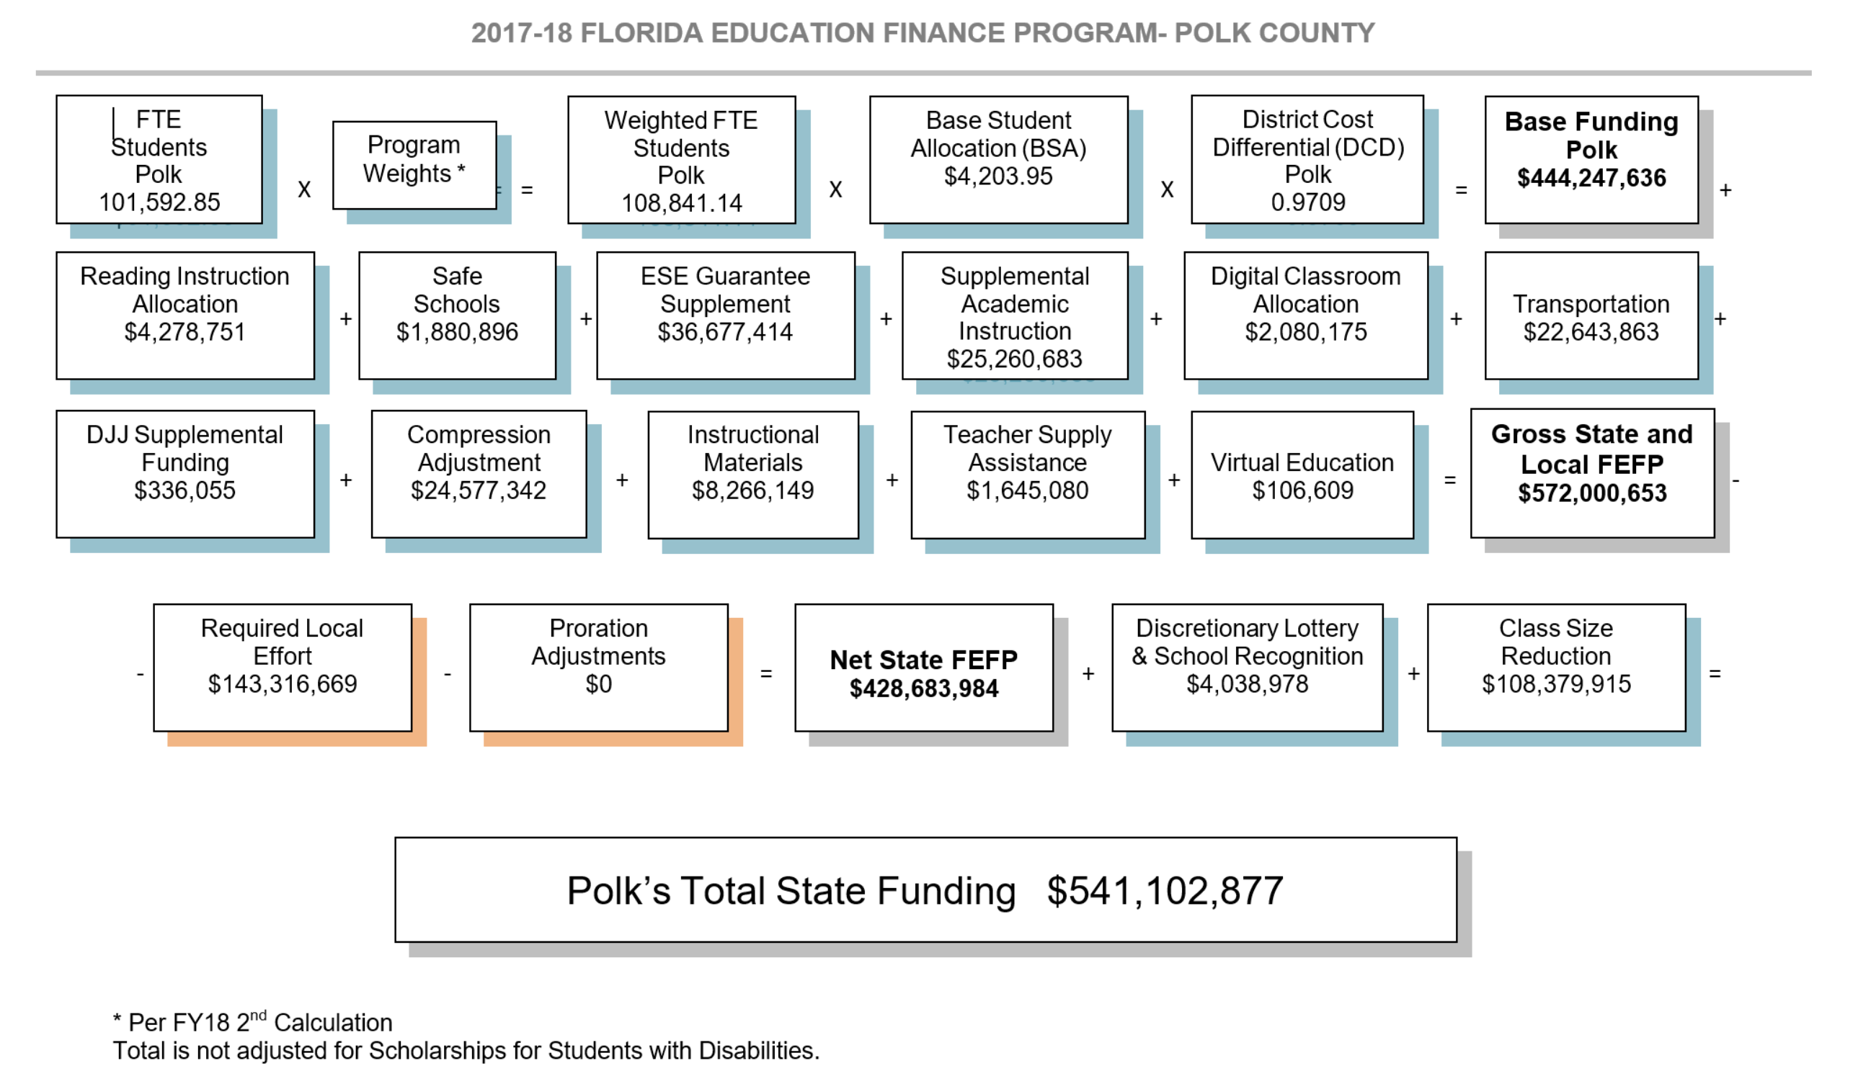
6

Slide 8
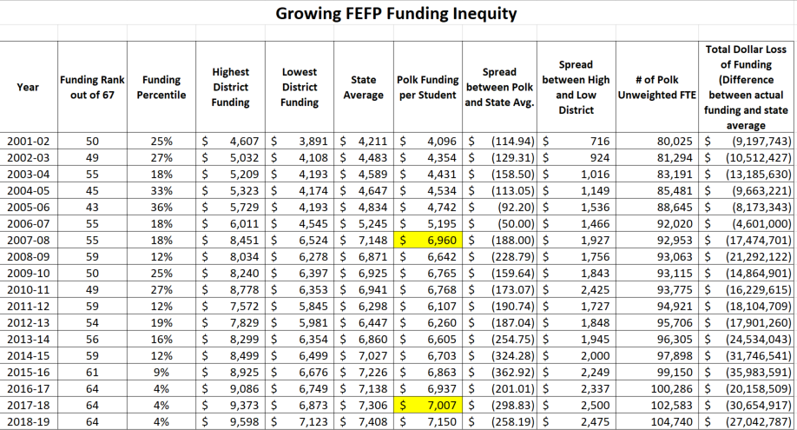
7
10-year loss
$237,220,873

Slide 9
8
State Average

Slide 10
9
Average Inflation Rate
$6,960
State Funding
United States Department of Labor
Consumer Price Index

Slide 11
Property Value Loss
10

Slide 12
Polk’s Biggest, Imminent Challenge – Capital Funding
11
½ cent sales tax expires December 2018 – A loss $40 million per year in capital funds if not renewed
Impact Fees – currently at 50% - growth not paying for itself
Local Capital Improvement funding limited to 1.5 mills by legislature
Lack of dedicated state capital funding (PECO)
Current Capital Shortfall - $400 million
Projected 5-year shortfall - $900 million
Concurrency

Slide 13
Polk County School Board Budget FY2017-2018
11
General Fund - $835 million
Special Revenue (Title funds, food service, other grants) - $180 million
Debt Service - $66 million
Capital - $192 million
Internal Services (Self-Insured Funds) - $124 million
Agency Accounts (Internal) - $24 million
Grand Total = $1.5 billion

Slide 14
13

Slide 15
General Fund Financial Health – Fund Balance
14
Board Policy – 5% (unassigned/assigned)
State minimum – 3%
State emergency intervention – 2%
Standard government agency benchmark – 60 days or 15%

Slide 16
15

Slide 17
FY 2018-2019 Budget Outlook
16
2018-19 New Items (Not including growth):
Fuel Cost Increase |  |  | 1,000,000
FRS rate increase |  |  | 1,500,000
Recurring Cost of 2017/18 raises |  |  | 8,159,000
Title 1 shift to General Fund
Coach Positions |  |  | 600,000
Professional Development at Turnaround schools |  |  | 3,500,000
Continuing Turnaround school incentives |  |  | 1,700,000
Employee Additional Benefit Package Expense |  |  | 15,000,000
TOTAL NEW EXPENSES |  |  | 31,459,000
NET INCREASE (Discretionary Revenue - Discretionary Expense)** |  |  | (13,625,823)
Needed to Reach State Mandated 3% Fund Balance |  |  | (3,730,576)
Needed to Reach Board Policy 5% Fund Balance |  |  | 11,547,914

Slide 18
Cost to Build a New School
17
Elementary - $30 million
Middle School - $40-$50 million
High School - $60-$80 million

